Slide 1

Rogue AI
COMSATS University Islamabad, Lahore Campus
First Person Shooting Video Game

Slide 2

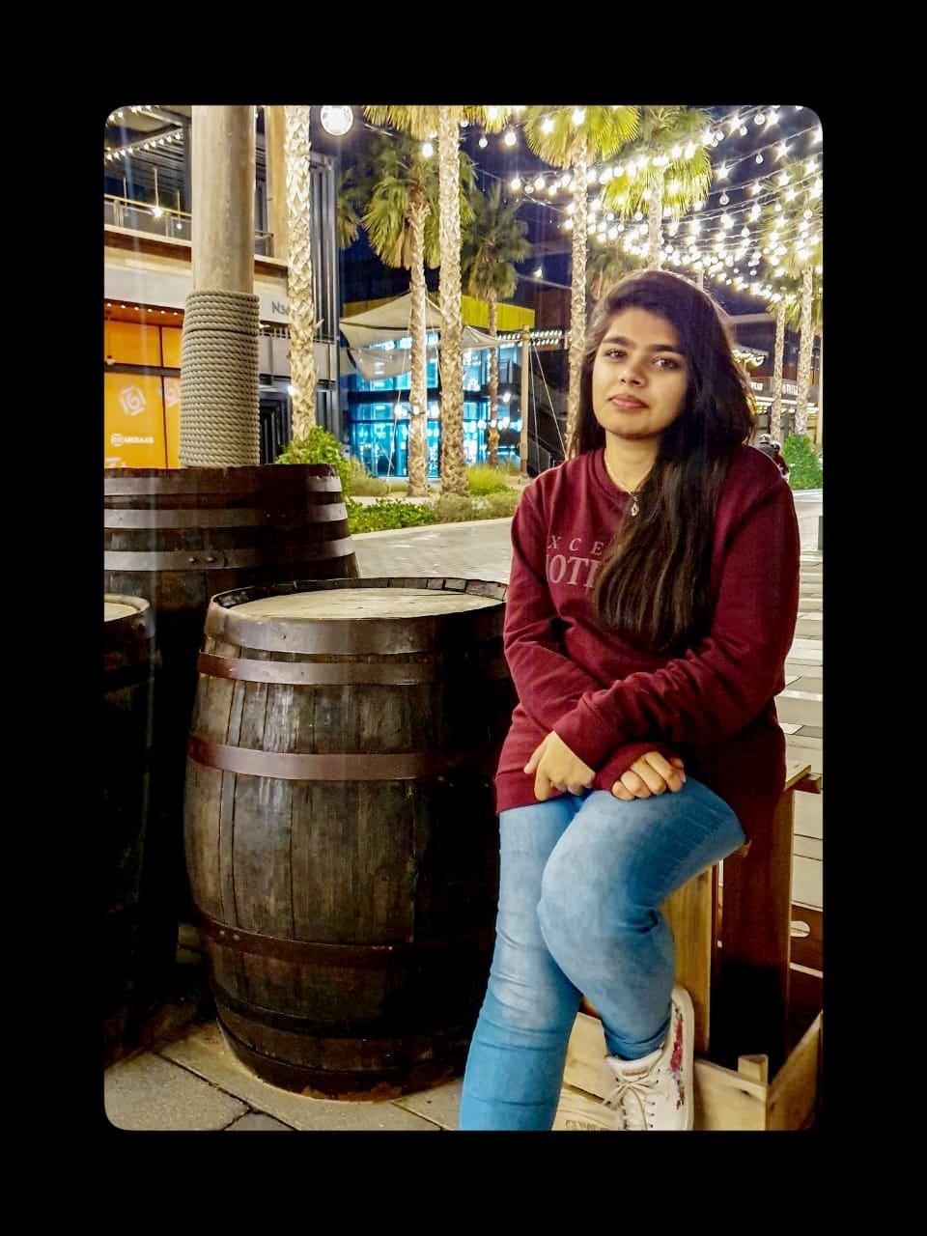

Team
Supervisor
Ms. Asmara Safdar
Team Member
Humza Butt
FA17-BSE-011
Team Member
Maha Ejaz
FA17-BSE-071
Team Member
Umer Saeed
FA17-BSE-038
Co-supervisor
Mr. Mohsin Mehdi

Slide 3
Agenda / Topics
Introduction
Motivation
Tools & Technology
Concept
Game design
Characters
Riddles
Game Play
Features
Future work
Demo

Slide 4
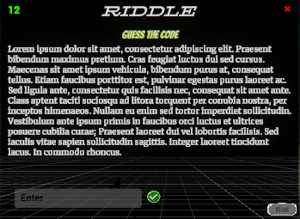
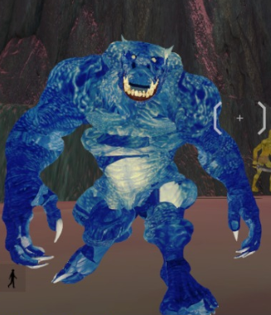
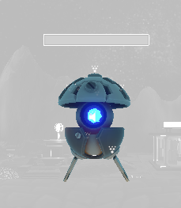
Introduction
Human vs Robots
Logical Riddles
Alien animals
Levels
Robot enemy
Alien animal
Riddle UI

Slide 5
Motivation
Logical thinking
Faster decision making
Fun
Polish skills

Slide 6
Tools & Technology
C#
Unity
Firebase
Blender
GitHub
Visual Studio
MS Visio
Photoshop

Slide 7
Concept

Slide 8
Goals
Kill enemies
Solve riddles
High Scores
Clear levels

Slide 9
Rules
Scoring rule
Health point rule
Gun rule
Level up rule

Slide 10
Challenges
Solve riddle in time
Save health
Destroy enemies

Slide 11
Interaction
Enemies
Pickups
Alien animals
Riddle

Slide 12
Design

Slide 13
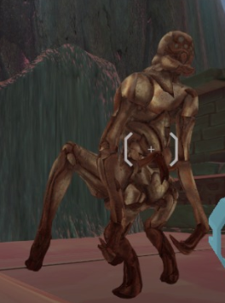
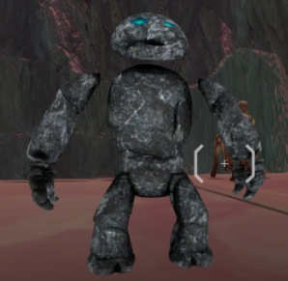
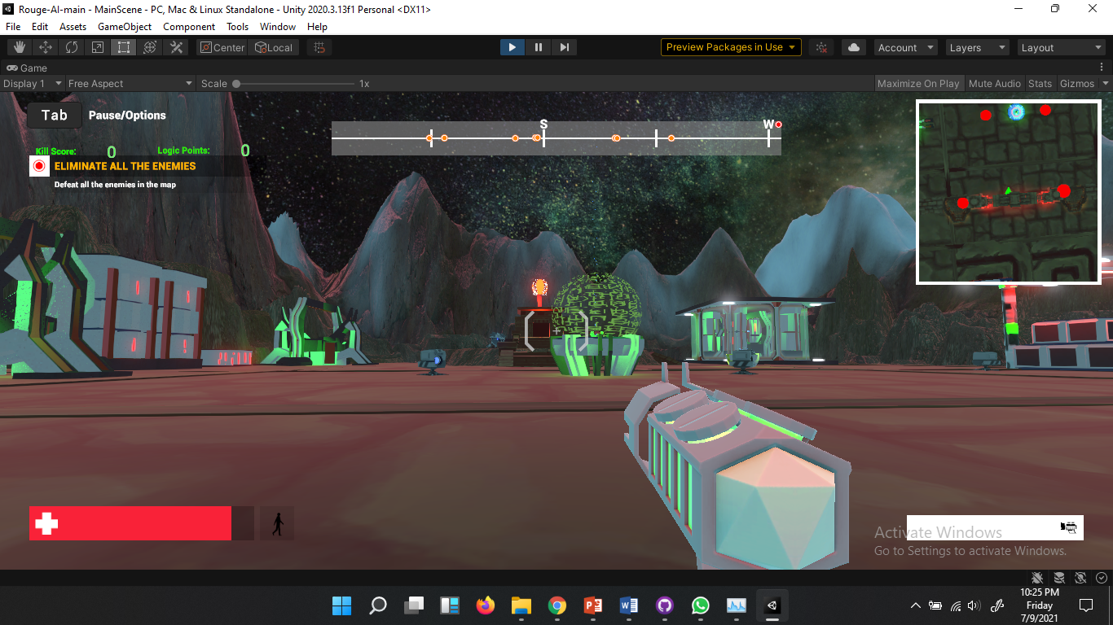
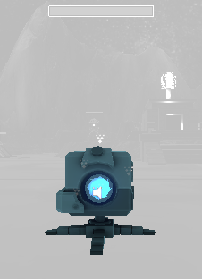
Game assets
Alien Animals
Guns
Robots

Slide 14
VFX
Textures
Alien animals
Walls
Floor
Robots
Animations
Fire
Doors
Alien animals
Gun
Meshes
Alien animals
Robots
Gun
Mountains
Ground
Audio clips
Gun sound
Hits
Game play

Slide 15
Characters

Slide 16
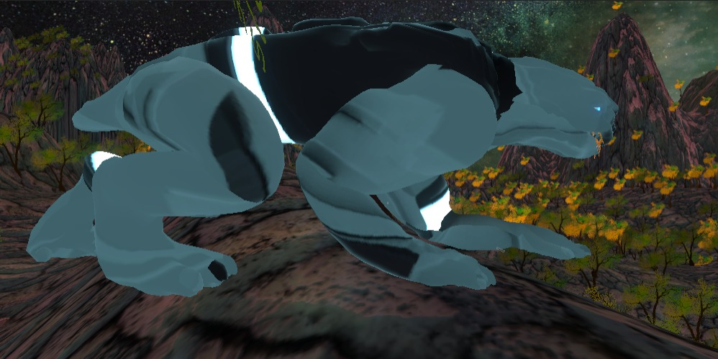
Animals
Healthy
Unhealthy
Blue Giant
Stone Man
Spider Ghost
Metal Cat

Slide 17
Enemies
Guard Bot
Defender

Slide 18
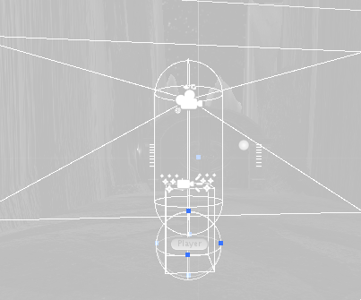
Player
Actual player geometry
User viewing angle

Slide 19
Riddles

Slide 20
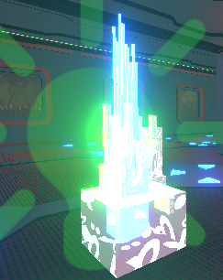
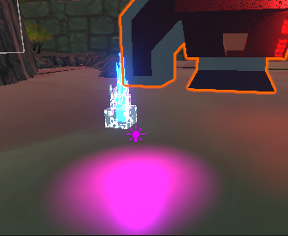
Pickup points
Compulsory
Non-Compulsory

Slide 21
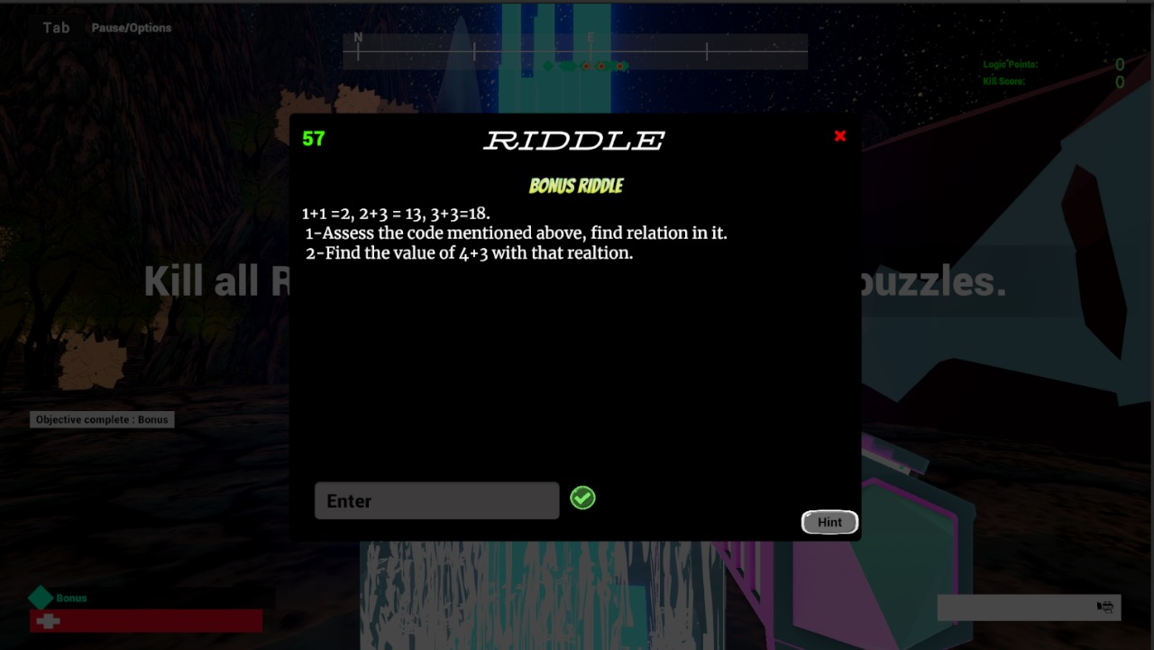
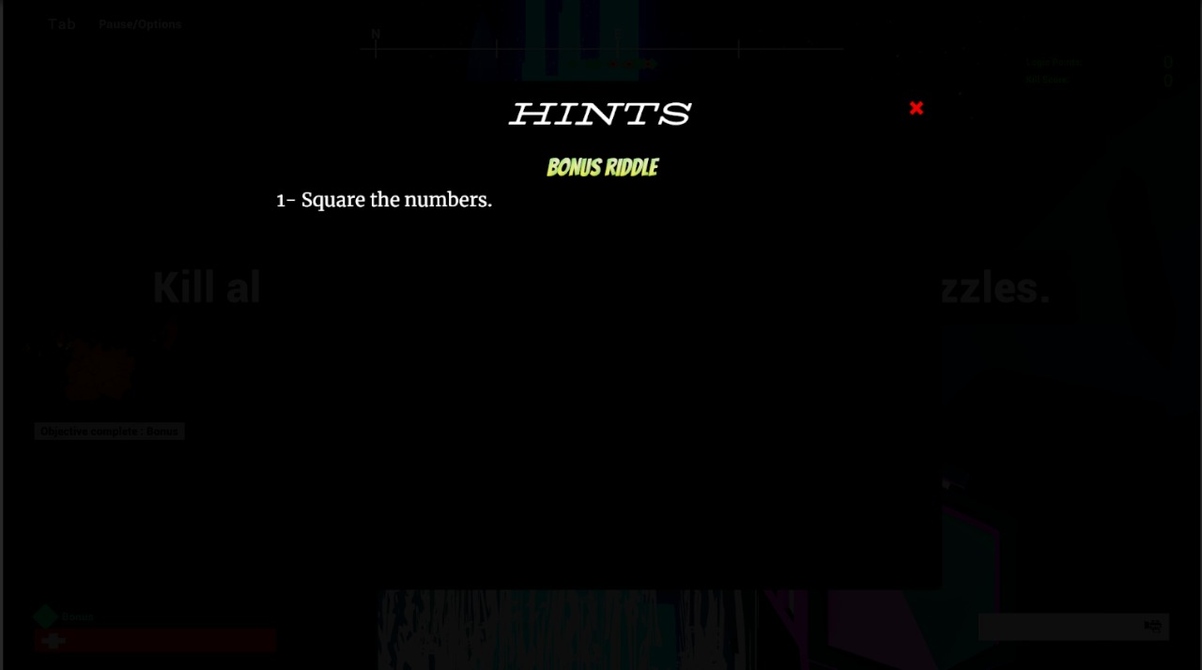
Riddle Interfaces

Slide 22
Game Play

Slide 23
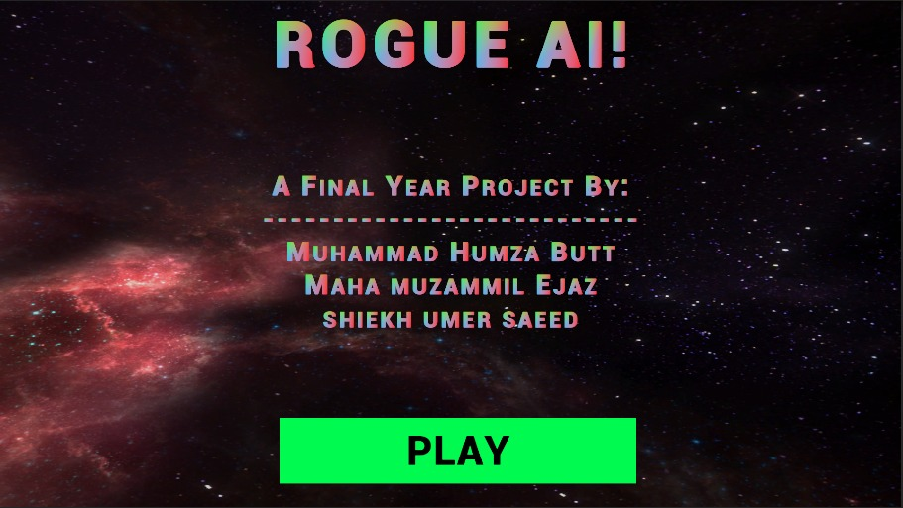
Introduction

Slide 24
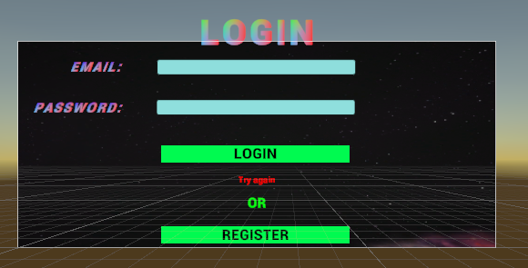
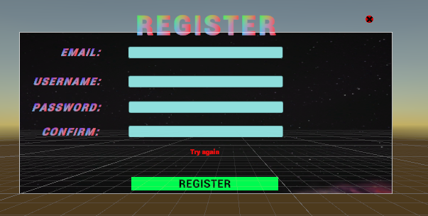
Login/Register

Slide 25
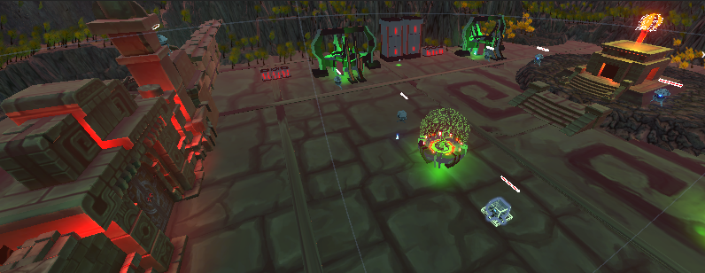
Level 1
Temple rock design
Low difficulty riddles
Less powerful enemies

Slide 26
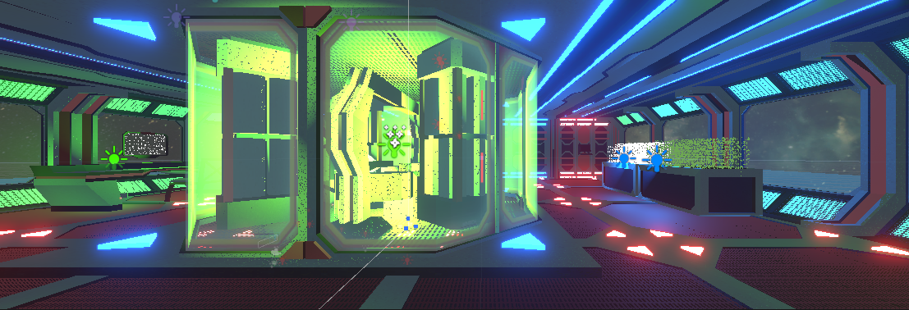
Level 2
Crew Lab design
New map
Medium difficulty riddles
Medium powerful enemies

Slide 27
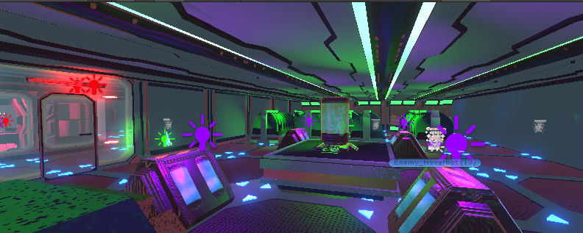
Level 3
Power complex design
New guns
New map
High difficulty riddles
More powerful enemies

Slide 28
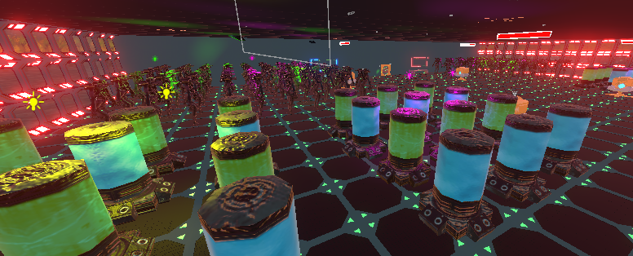
Level 4
Space complex design
Boss enemy
New map
High difficulty riddles

Slide 29
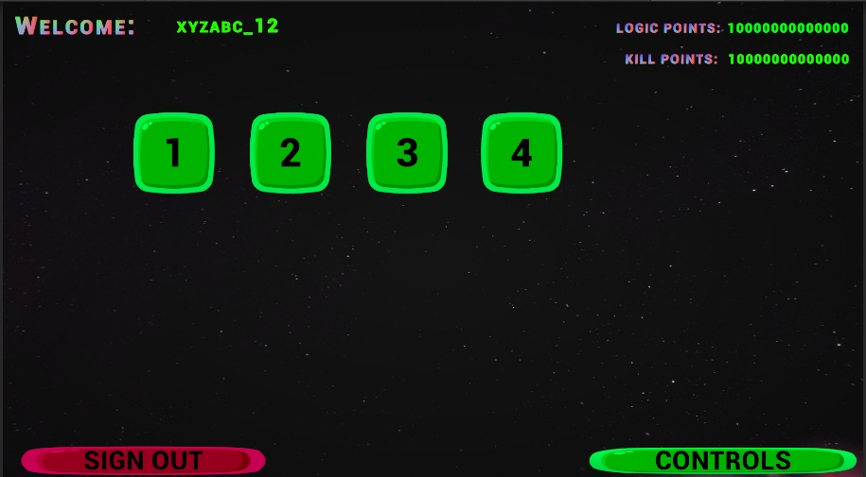
Level selector

Slide 30
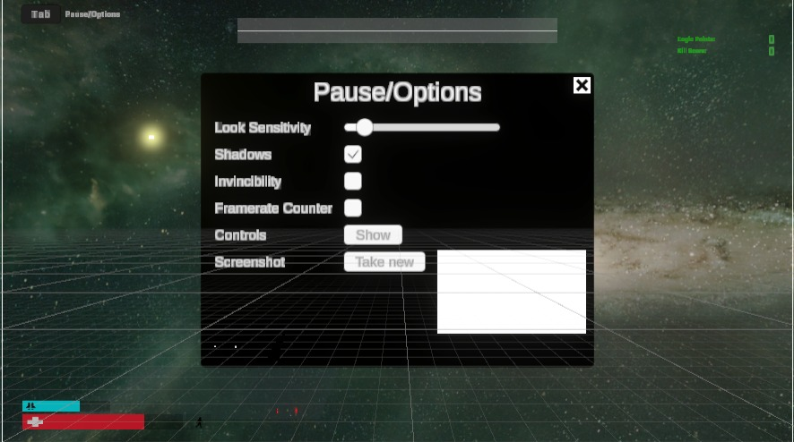
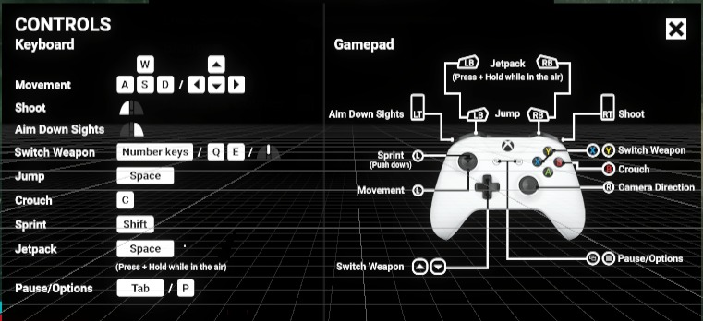
Control Screen

Slide 31

Mission Complete

Slide 32
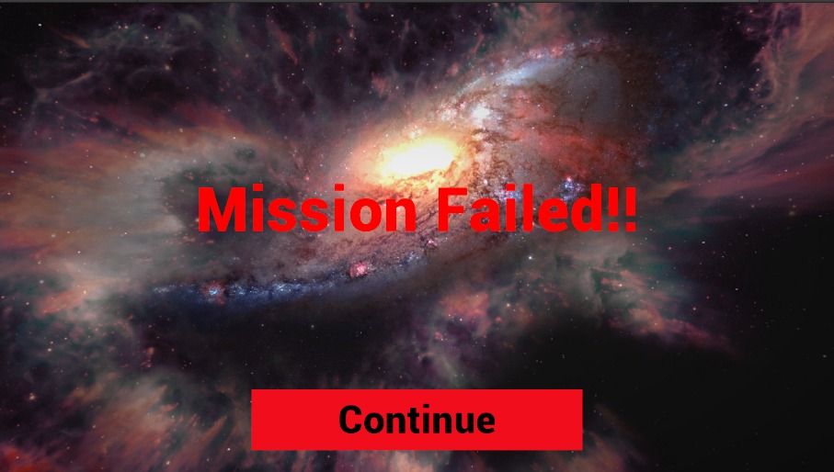
Mission Failed

Slide 33
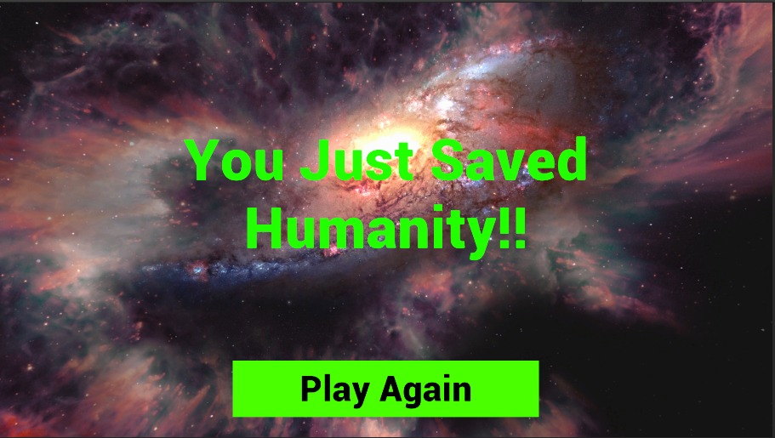
Game Complete

Slide 34
Features

Slide 35
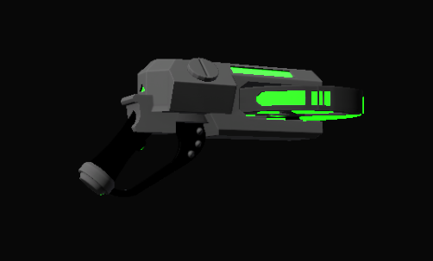
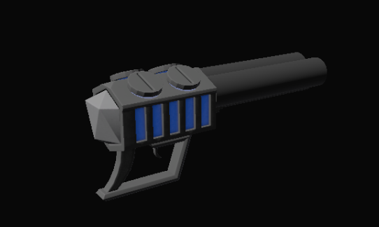
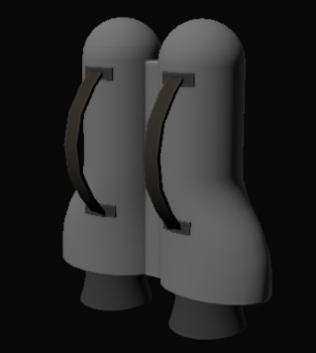
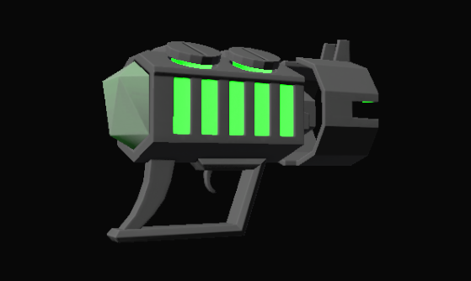
Guns
Jetpack

Slide 36
Future work
Marketplace
More enemies
More pickups
Reward schemes
New Designs
Time bound missions
Save game state

Slide 37
Source
Source Code
https://github.com/humza-13/Rogue-AI
Latest Release
https://github.com/humza-13/Rogue-AI/releases/tag/v1.1.4-beta
YouTube Demonstration
https://www.youtube.com/watch?v=_XixK6oeSu8

Slide 38
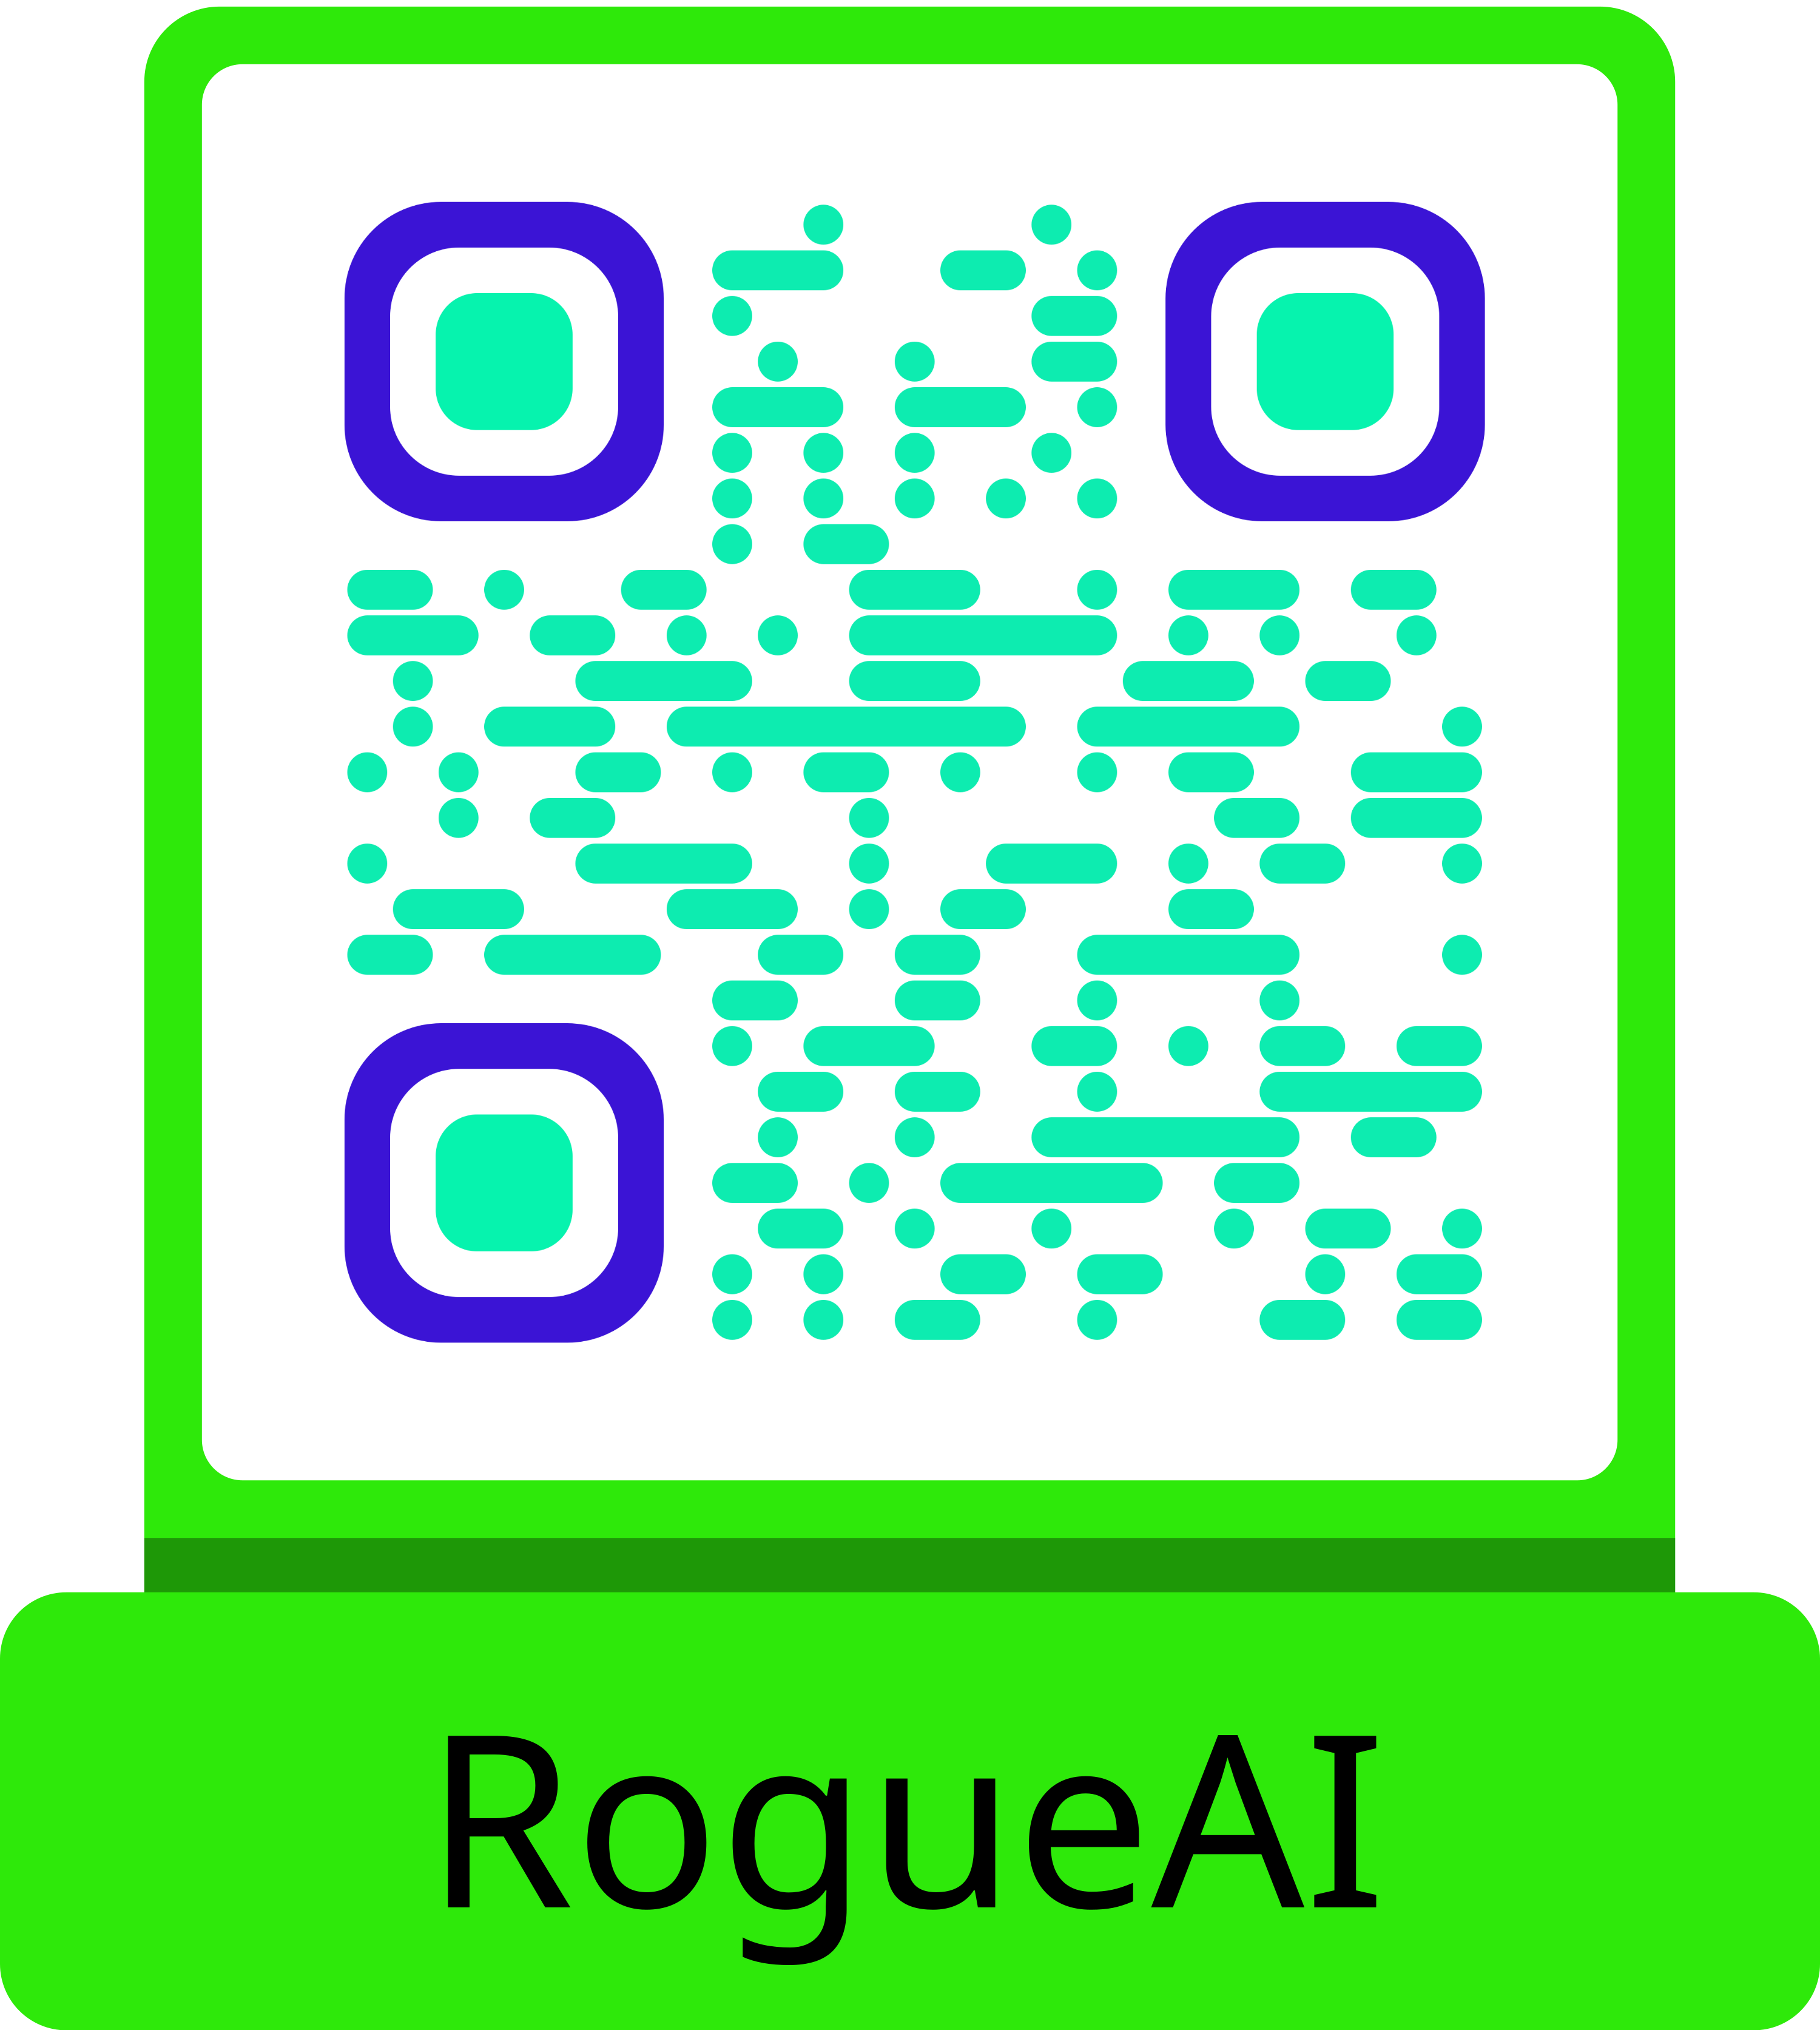
Source (Cont.)

Slide 39
COMSATS University Islamabad, Lahore Campus
Thank you

